Slide 1




Hotel Reservation & Flight Booking System
Made with
HRFBS is a relational data model and reporting project built in PostgreSQL.

Slide 2
Project Overview
User Management
Financial Layer
RBAC Implementation with 'customer' and 'admin' roles. Secure authentication with password hashing support.
Unified payment table with strict 1:1 mapping to bookings. Support for multiple payment methods (credit card, cash, online).
Hotel Logistics
Engagement Layer
Multi-room support per hotel with derived availability. Dynamic pricing per room type (single, double, suite).
Review system for both airlines and hotels with "one review per stay" enforcement. 1-5 star rating scale.
Aviation Logistics
Core Philosophy
Flight scheduling with physical seat mapping (1A, 1B, etc.). Real-time seat availability tracking.
Data Integrity at the Schema Level — Business logic enforced via PostgreSQL constraints, triggers, and indexes rather than application code.
10 Tables
12 BI Queries
3 Advanced Patterns

Slide 3
System Architecture & ERD
Entity Extraction
USERS
HOTELS
ROOMS
HOTEL_BOOKINGS
AIRLINES
user_id PK
hotel_id PK
room_id PK
booking_id PK
airline_id PK
name
name
hotel_id FK
user_id FK
name UK
email UK
location
type
room_id FK
role
rating
price
check_in/out
FLIGHTS
SEATS
FLIGHT_BOOKINGS
PAYMENTS
REVIEWS
flight_id PK
seat_id PK
booking_id PK
payment_id PK
review_id PK
airline_id FK
flight_id FK
user_id FK
hotel_booking FK
user_id FK
departure
seat_number
flight_id FK
flight_booking FK
hotel_id FK
arrival
seat_id FK
amount
airline_id FK

Slide 4
Entity Extraction
Users
Hotels
Rooms
Airlines
Flights
Seats
Hotel Bookings
Flight Bookings
Payments
Reviews

Slide 5

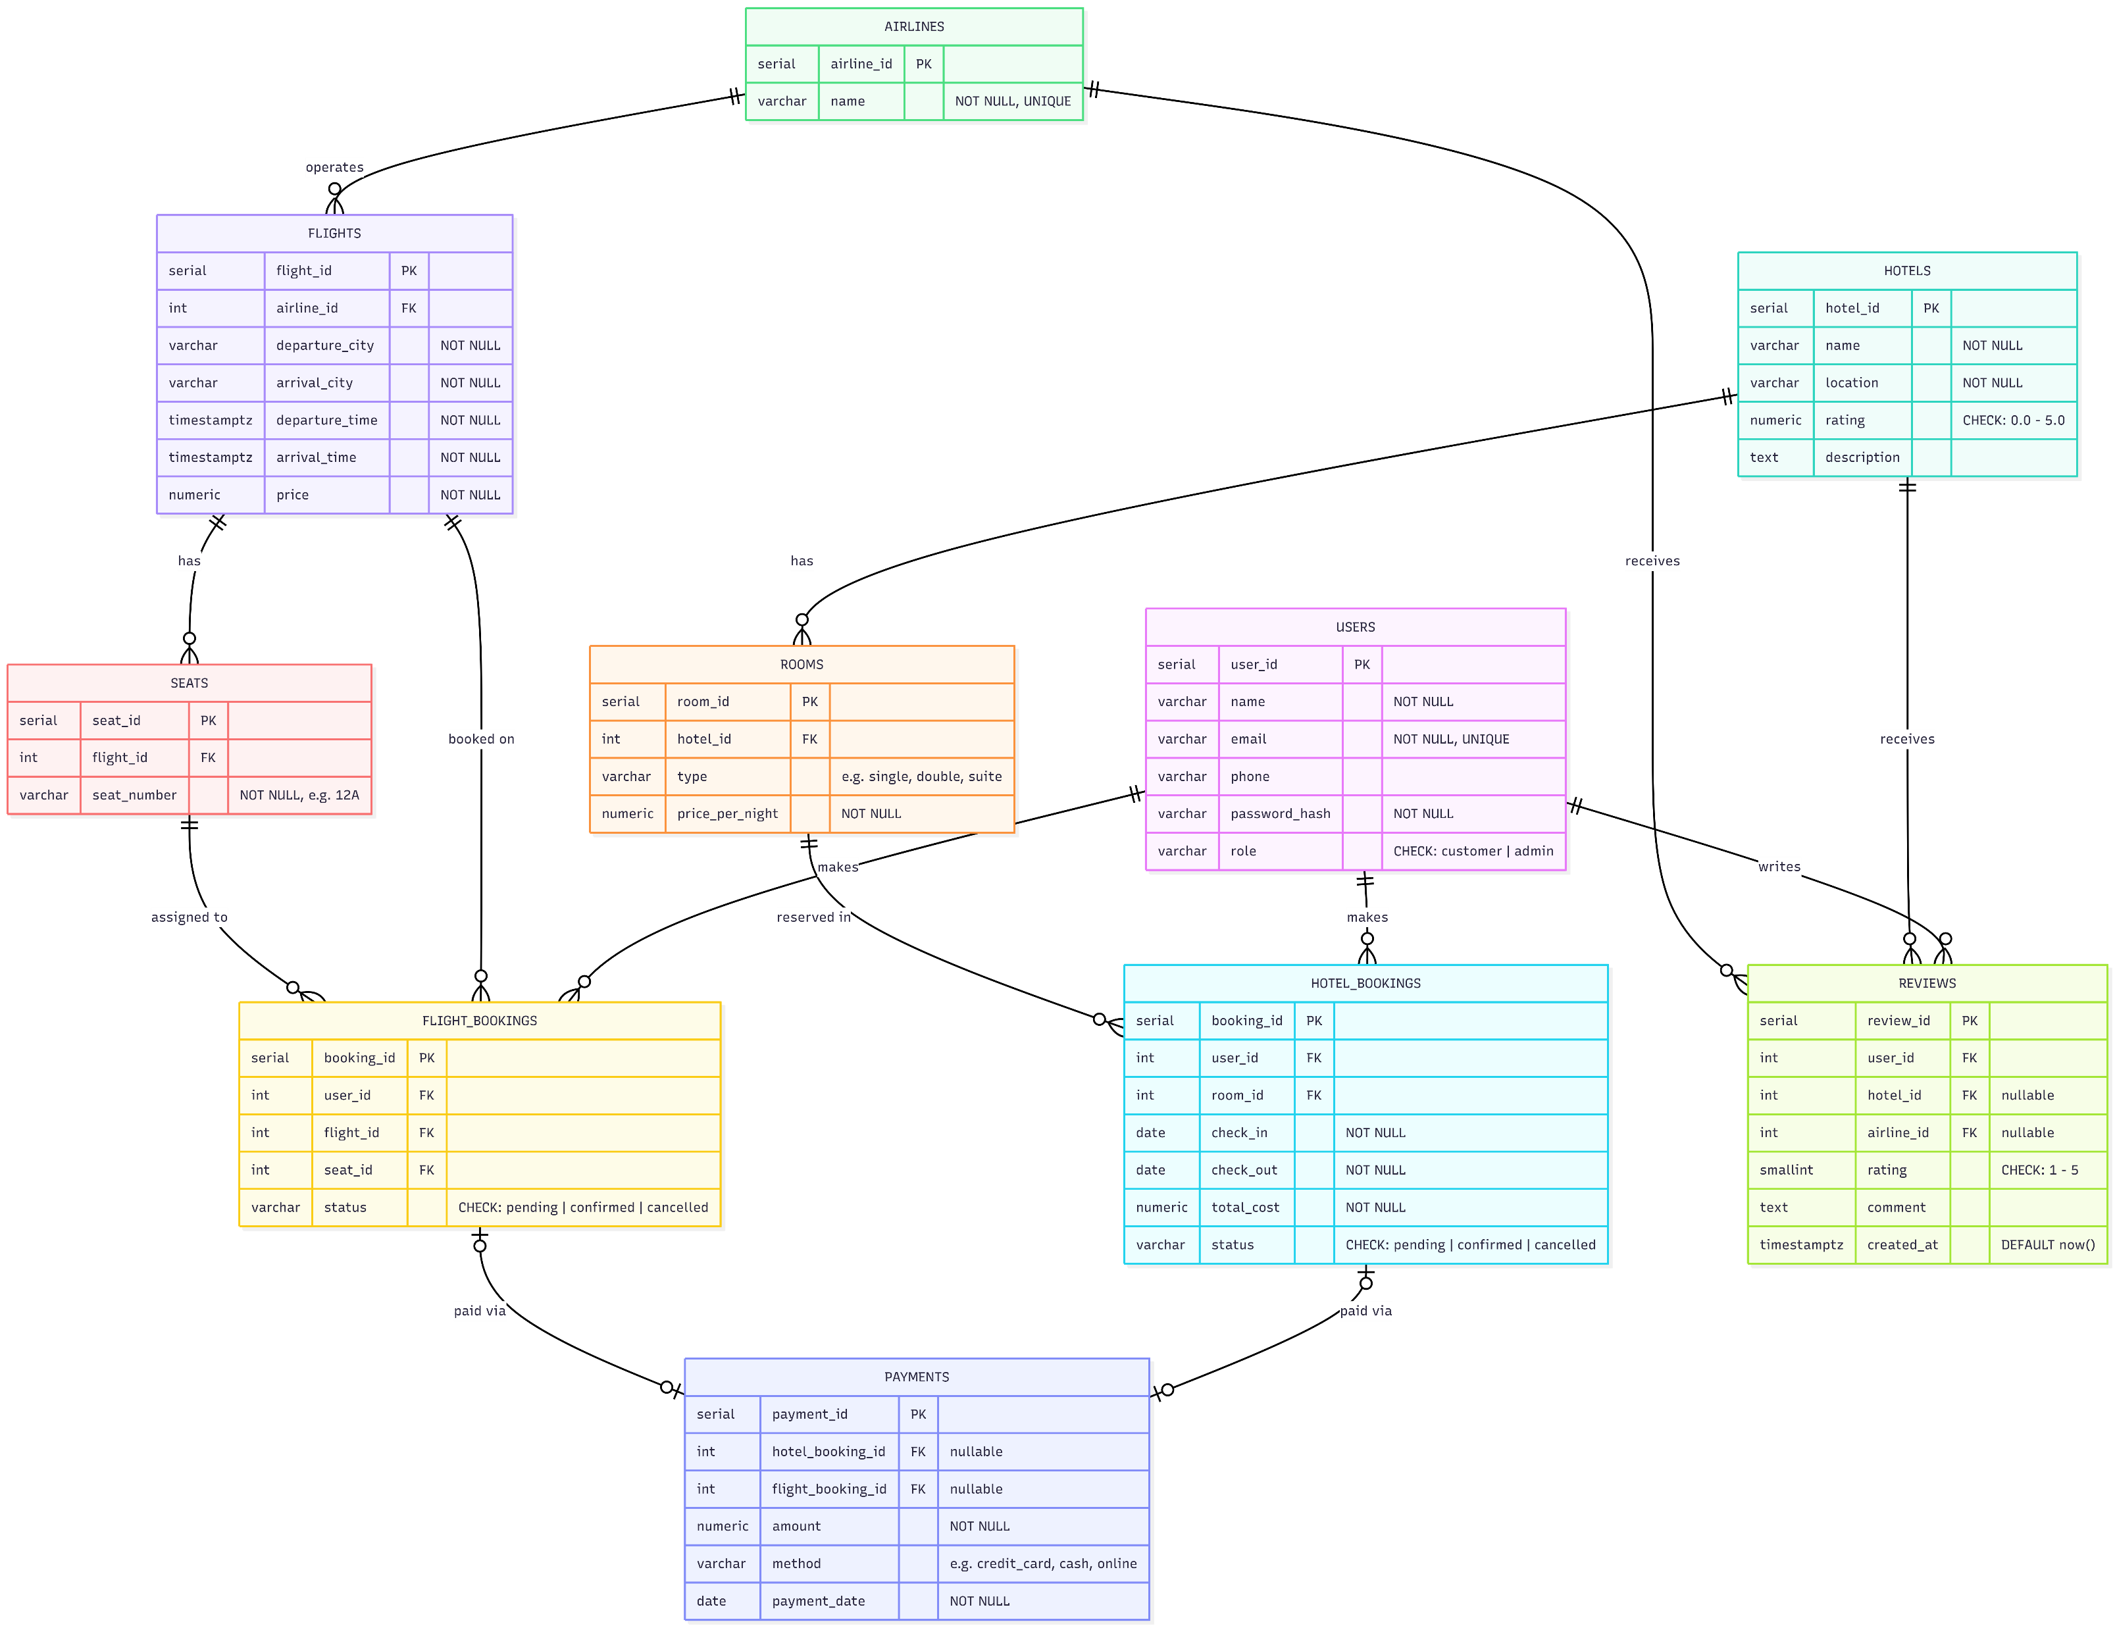
Entity Relationship Diagram
User Relationships
Hierarchy
Financial & Reviews
Users → Hotel Bookings (1:M)
Users → Flight Bookings (1:M)
Users → Reviews (1:M)
Hotels → Rooms (1:M)
Airlines → Flights (1:M)
Flights → Seats (1:M)
Bookings → Payments (1:1)
Hotels/Airlines → Reviews (1:M)
XOR Pattern for polymorphism

Slide 6
User Relationships
Users → Hotel Bookings (1:M)
Users → Flight Bookings (1:M)
Users → Reviews (1:M)

Slide 7
User Relationships
Users → Hotel Bookings (1:M)
Users → Flight Bookings (1:M)
Users → Reviews (1:M)

Slide 8
Hierarchy
Hotels → Rooms (1:M)
Airlines → Flights (1:M)
Flights → Seats (1:M)

Slide 9
Hierarchy
Hotels → Rooms (1:M)
Airlines → Flights (1:M)
Flights → Seats (1:M)

Slide 10
Financial & Reviews
Bookings → Payments (1:1)
Hotels/Airlines → Reviews (1:M)
XOR Pattern for polymorphism

Slide 11
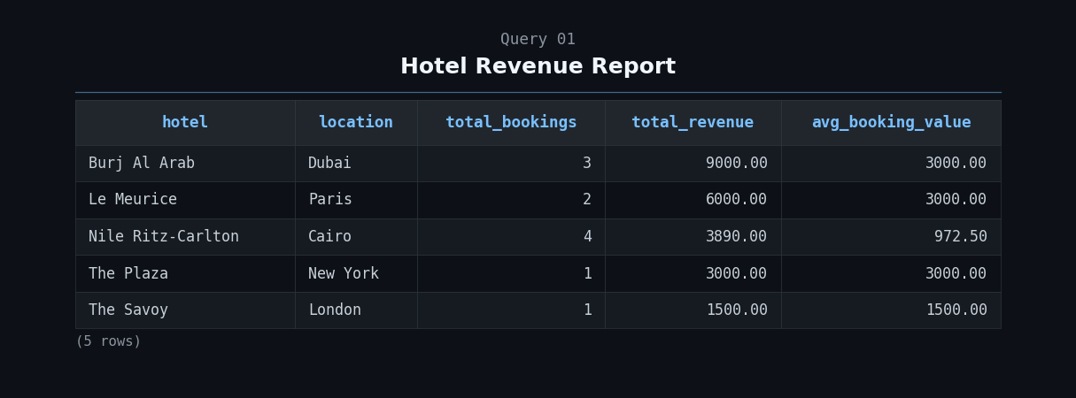
How much has each hotel made from confirmed bookings?

Slide 12
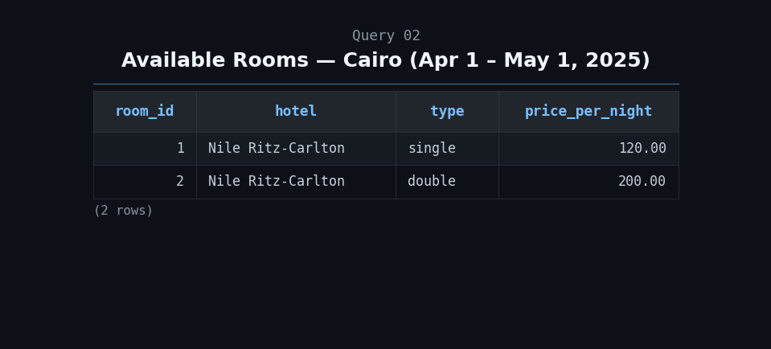
Which rooms are free in Cairo between Apr, 1st and May, 1st?

Slide 13
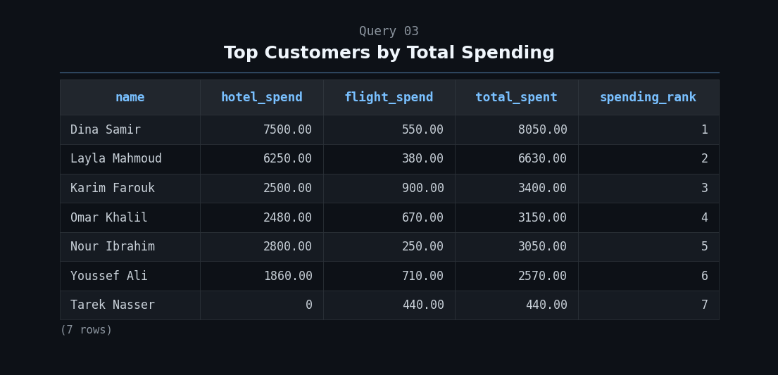
Who is spending the most across both booking types?

Slide 14
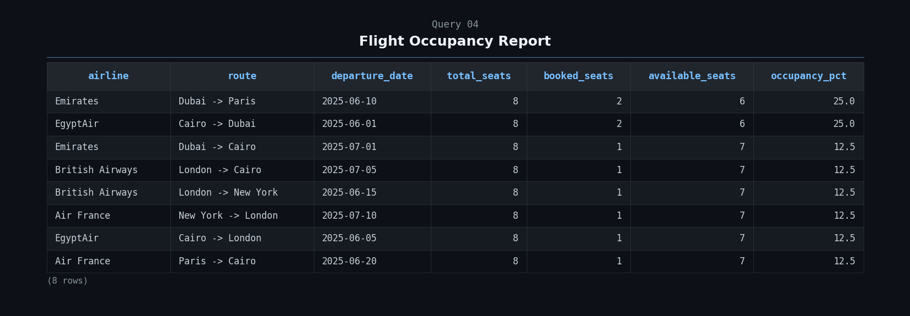
For each flight, how full is it?

Slide 15
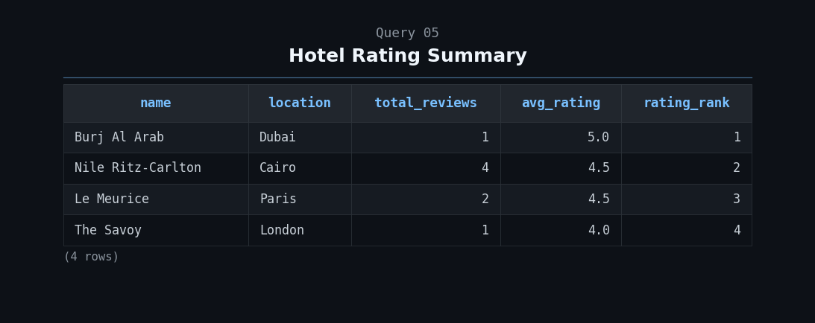
Which hotels are guests actually happy with?

Slide 16
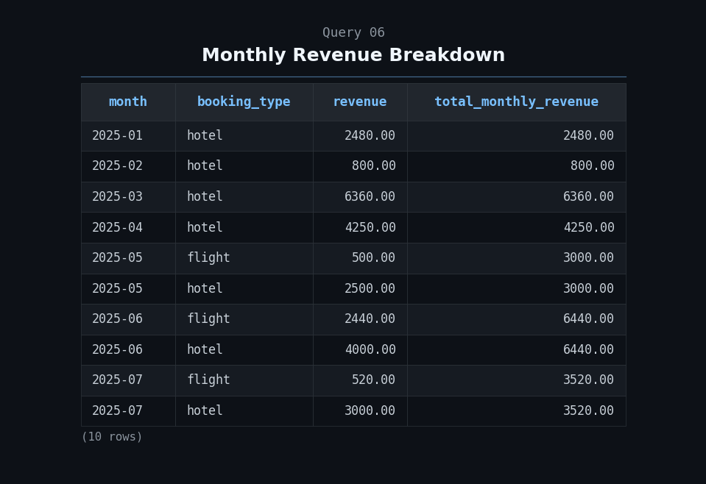
How much came in each month, split by hotel vs flight?

Slide 17
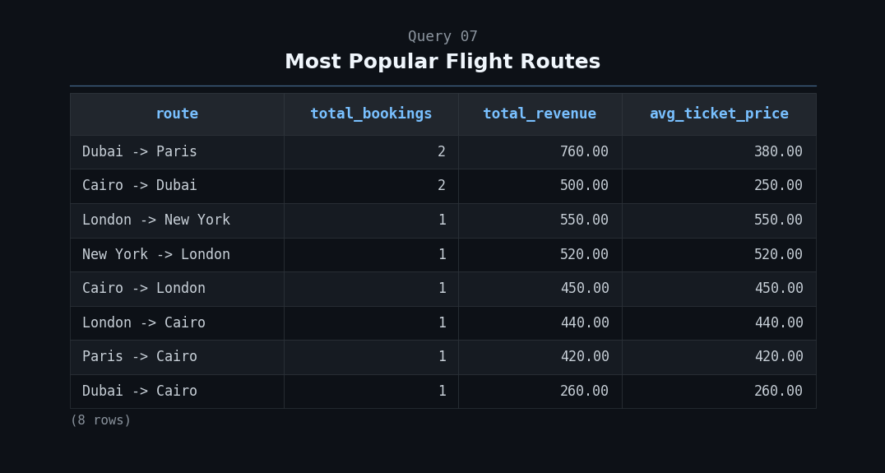
Which routes get the most bookings and revenue?

Slide 18
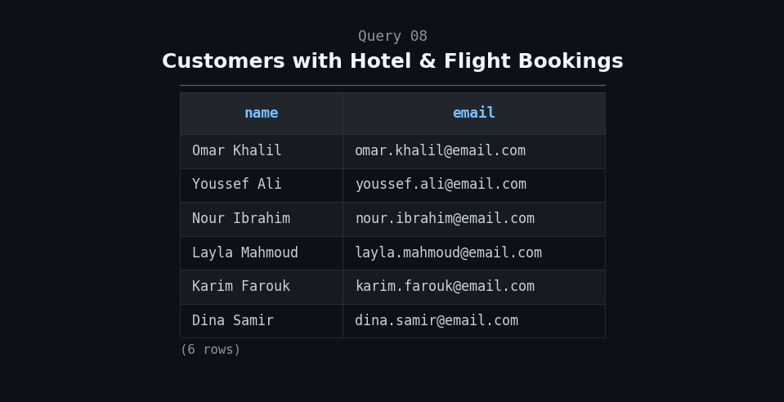
Which customers booked both a hotel and a flight?

Slide 19
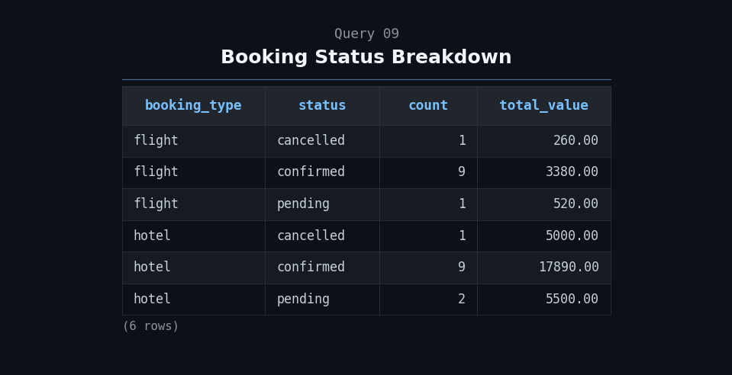
What's the ratio of (confirmed/pending/cancelled) across both booking types?

Slide 20
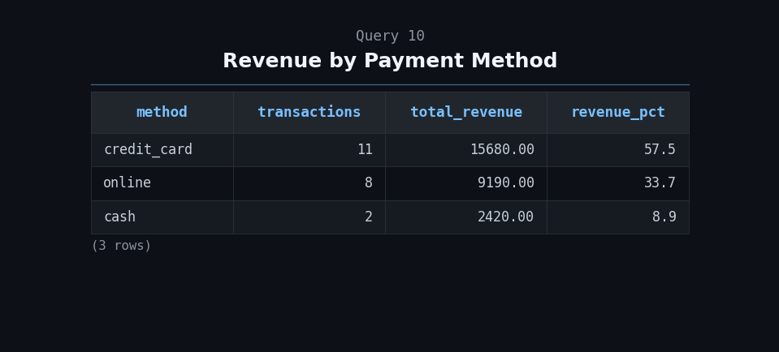
Which payment method brings in the most money?

Slide 21
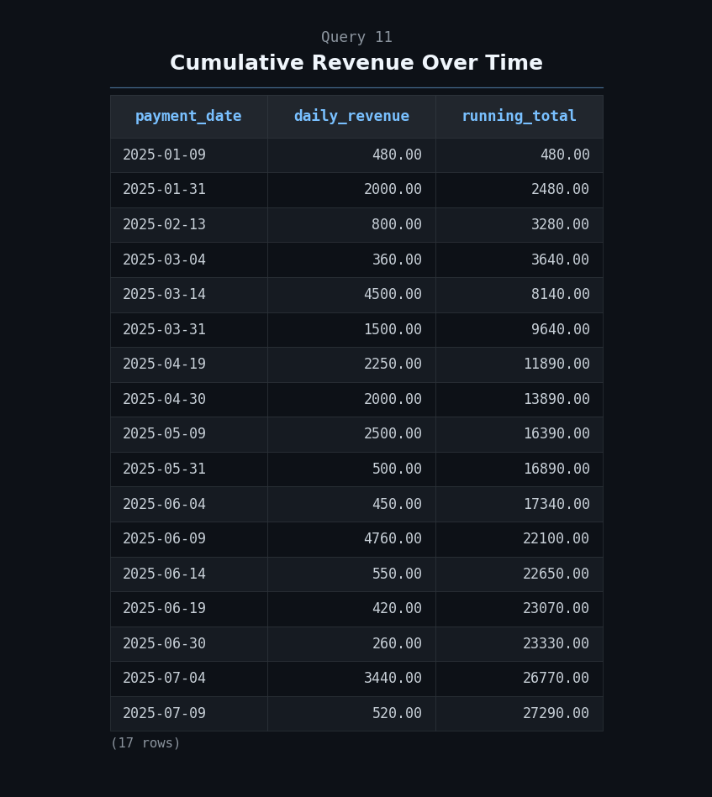
What does the day-by-day revenue growth look like?

Slide 22
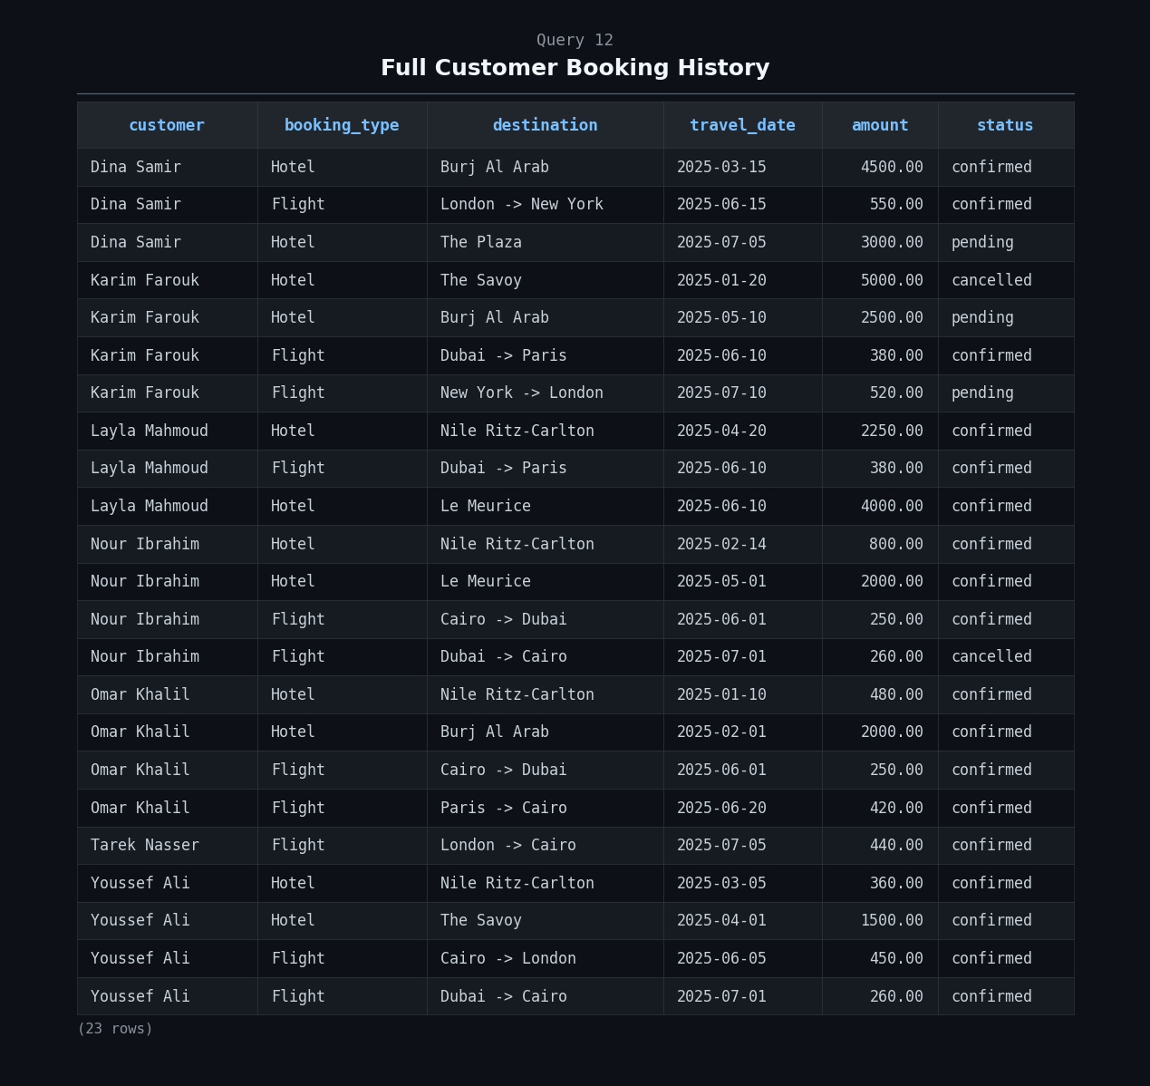
Every booking a customer ever made, hotel or flight, in one unified list.

Slide 23
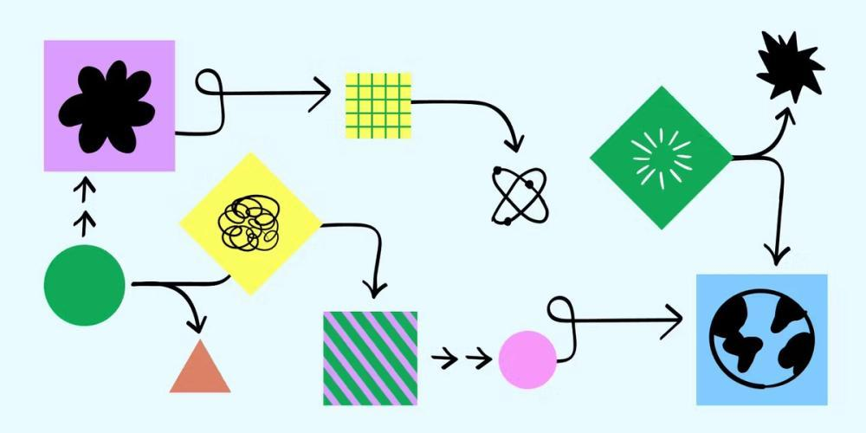

Decisions & Problems Solved

Slide 24
Schema Design: The XOR Pattern
The Challenge
PAYMENTS Table
How do we link a payment to either a hotel booking OR a flight booking, but never both, and never neither?
CREATE TABLE payments ( payment_id SERIAL PRIMARY KEY, hotel_booking_id INT REFERENCES hotel_bookings, flight_booking_id INT REFERENCES flight_bookings, amount NUMERIC(10,2) NOT NULL, method VARCHAR(50) NOT NULL, payment_date DATE NOT NULL, -- XOR CONSTRAINT: CHECK ( (hotel_booking_id IS NOT NULL AND flight_booking_id IS NULL) OR (hotel_booking_id IS NULL AND flight_booking_id IS NOT NULL) ) );
Traditional approach: Complex bridge tables with overhead
Our Solution
Polymorphic design using PostgreSQL CHECK constraints to enforce exactly-one-parent rule at the schema level.
Prevents orphaned records
No complex bridge tables needed
Single source of truth
REVIEWS Table
CREATE TABLE reviews ( review_id SERIAL PRIMARY KEY, user_id INT NOT NULL REFERENCES users, hotel_id INT REFERENCES hotels, airline_id INT REFERENCES airlines, rating SMALLINT CHECK (rating BETWEEN 1 AND 5), comment TEXT, -- Same XOR pattern: CHECK ( (hotel_id IS NOT NULL AND airline_id IS NULL) OR (hotel_id IS NULL AND airline_id IS NOT NULL) ) );
No Orphaned Records
Schema-Level Enforcement
Clean Data Architecture

Slide 25
Temporal Integrity
Double-Booking Prevention for Rooms
The Challenge
PL/pgSQL Trigger
How do we prevent double-booking the same room while allowing same-day turnover (e.g., check-out 11 AM, check-in 3 PM)?
CREATE FUNCTION check_room_double_booking() RETURNS TRIGGER AS $$ BEGIN IF EXISTS ( SELECT 1 FROM hotel_bookings WHERE room_id = NEW.room_id AND status != 'cancelled' AND booking_id != COALESCE( NEW.booking_id, -1) AND check_in < NEW.check_out AND check_out > NEW.check_in ) THEN RAISE EXCEPTION 'Room % already booked!', NEW.room_id; END IF; RETURN NEW; END; $$ LANGUAGE plpgsql;
Interval overlap detection required!
The Overlap Formula
(StartA < EndB) AND (EndA > StartB)
Two intervals overlap if each starts before the other ends. This correctly handles edge cases like back-to-back bookings.
Trigger Registration
CREATE TRIGGER trg_no_double_booking BEFORE INSERT OR UPDATE ON hotel_bookings FOR EACH ROW EXECUTE FUNCTION check_room_double_booking();
Prevents double-booking • Allows same-day turnover • Schema-level enforcement

Slide 26
Hotel Reservation & Flight Booking System
This system represents a diamond-level implementation of a travel booking engine. By shifting business logic from application code into the database schema, HRFBS ensures a "Single Source of Truth" that is immune to common synchronization bugs.
Schema-Level Integrity
12 BI Queries
Advanced Patterns
Business logic enforced via constraints, triggers & indexes
Actionable insights for stakeholders & decision makers
XOR, Partial Indexes, Temporal Triggers
10 Tables
3 Patterns
1 Truth
The End →

